Slide 1
Error Correcting Codes and Cryptosystem
2021.7.22

Slide 2
Linear Code and Hamming Code

Slide 3
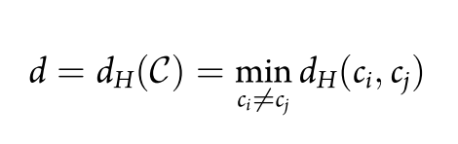
Hamming Distance

Slide 4
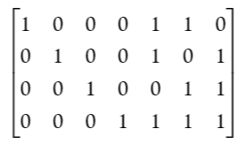
Example on Hamming Code
[n, k, d] = [7, 4, 3]
b4 = b0 ⊕ b1 ⊕ b3
b5 = b0 ⊕ b2 ⊕ b3
b6 = b1 ⊕ b2 ⊕ b3

Slide 5
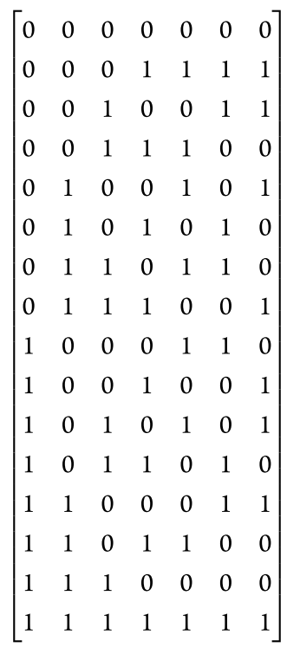
Example on Hamming Code
Given [1, 1, 0, 1, 0, 1, 0] is received,
We can trace back 0101 as the origin message.

Slide 6
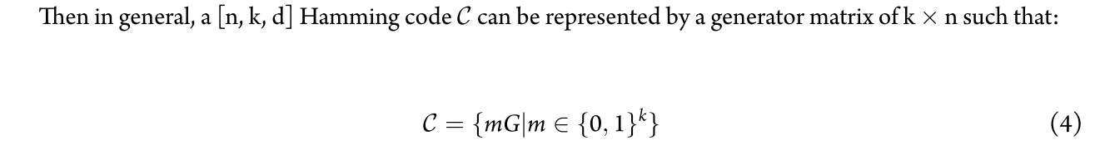
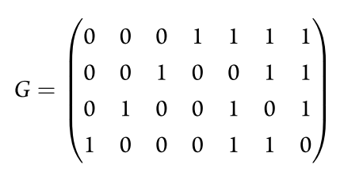
Generator Matrix Revisit

Slide 7


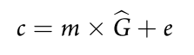
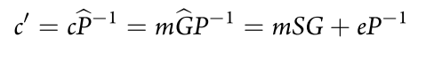
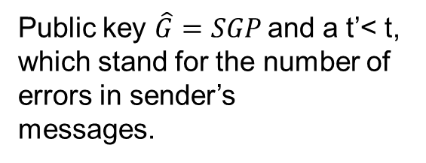
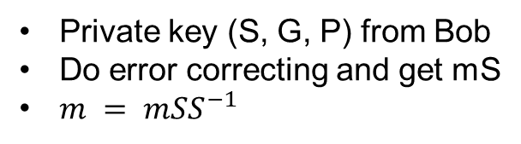
Error Correcting Cryptosystem
Initial setup:
S is a random invertible k × k matrix from Bob
G is a k × n coding generator matrix that corrects up to t errors
P is a random n × n permutation matrix
Public key $\hat{G}=SGP$and a t’< t, which stand for the number of errors in sender’s
messages.
Encryption:
A message m
A random error vector e is selected according to t′ in public key
Decryption:
Private key (S, G, P) from Bob
Do error correcting and get mS
$m = mSS^{−1}$

Slide 8
Thank you

